Slide 1
END Review Project Presentation
Project Guide – Dr. Sujit Das
Team Members
Nithish Krishna Shreenevasan (207151),
Yaswanth Reddy(207149)
Rahul Kumar Singh (207158)

Slide 2
A Hybrid ANN for Airfoil Self-Noise Prediction using Hyperbolic Secant and Levy Flights based GreyWolf Optimization

Slide 3
Problem statement
Background:
Noise emissions, including airfoil self-noise, are a major environmental concern across industries like aviation, energy, and civil engineering.
Airfoil self-noise, generated by airflow over surfaces, impacts various applications such as aircraft lifting devices, turbine fans, and wind turbine blades.
Current Challenges:
Existing semi-empirical models, like the Brooks-Pope-Marcolini (BPM) model, have limitations:
Lack of generality beyond specific airfoil profiles.
Over-reliance on assumptions about boundary layer effects, leading to prediction errors.
Objective:
Develop a more versatile and accurate predictive model for airfoil self-noise, overcoming limitations of existing models.

Slide 4
Grey wolves Optimization Algorithm
In the GWO algorithm, grey wolf individuals are divided into four classes: α, β, δ and ω.
α is mainly responsible for participating in the decision-making and management of the pack. ω is for other grey wolf individuals.
β and δ are for grey wolf individuals with the second and third highest adaptation level to α.

Slide 5
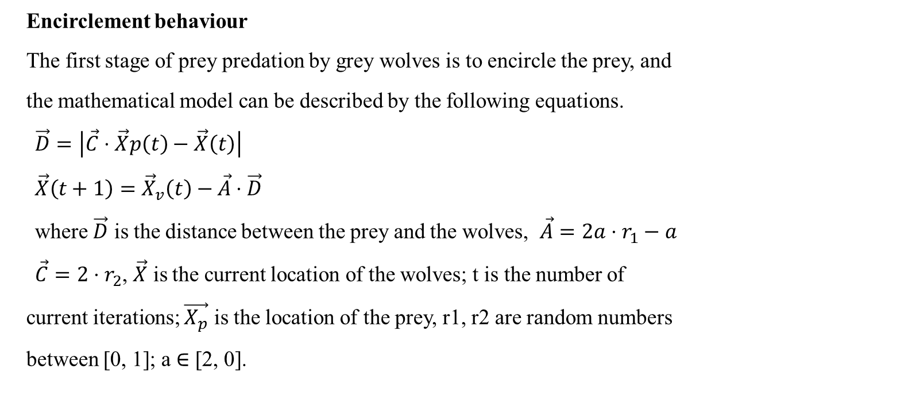
Grey wolves Optimization Algorithm
Encirclement behaviour
The first stage of prey predation by grey wolves is to encircle the prey, and
the mathematical model can be described by the following equations.
$\vec{D}=\left|\vec{C}⋅\vec{X}p\left(t\right)−\vec{X}\left(t\right)\right|$
$\vec{X}\left(t+1\right)={\vec{X}}_{v}\left(t\right)−\vec{A}⋅\vec{D}$
where $\vec{D}$ is the distance between the prey and the wolves, $\vec{A}=2a⋅r_{1}−a$
$\vec{C}=2⋅r_{2}$, $\vec{X}$ is the current location of the wolves; t is the number of
current iterations; $\vec{X_{p}}$ is the location of the prey, r1, r2 are random numbers
between [0, 1]; a ∈ [2, 0].

Slide 6
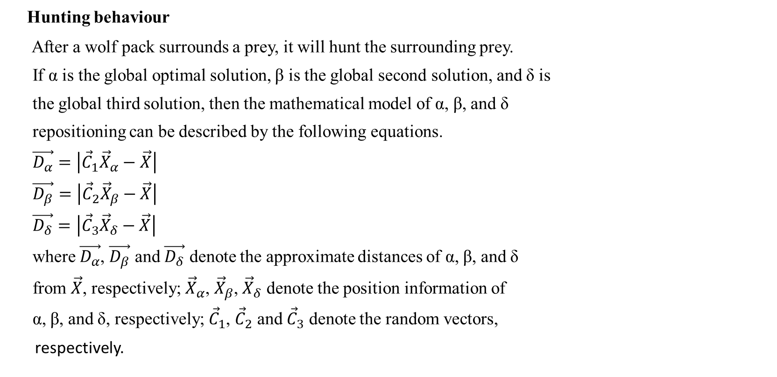
Grey wolves Optimization Algorithm
Hunting behaviour
After a wolf pack surrounds a prey, it will hunt the surrounding prey.
If α is the global optimal solution, β is the global second solution, and δ is
the global third solution, then the mathematical model of α, β, and δ
repositioning can be described by the following equations.
$\vec{D_{α}}=\left|{\vec{C}}_{1}{\vec{X}}_{α}−\vec{X}\right|$
$\vec{D_{β}}=\left|{\vec{C}}_{2}{\vec{X}}_{β}−\vec{X}\right|$
$\vec{D_{δ}}=\left|{\vec{C}}_{3}{\vec{X}}_{δ}−\vec{X}\right|$
where $\vec{D_{α}}$, $\vec{D_{β}}$ and $\vec{D_{δ}}$ denote the approximate distances of α, β, and δ
from $\vec{X}$, respectively; ${\vec{X}}_{α}$, ${\vec{X}}_{β}$, ${\vec{X}}_{δ}$ denote the position information of
α, β, and δ, respectively; ${\vec{C}}_{1}$, ${\vec{C}}_{2}$ and ${\vec{C}}_{3}$ denote the random vectors,
respectively.

Slide 7

Grey wolves Optimization Algorithm
Hunting behaviour
The current solution $\vec{X}$ and the updated solution $\vec{X}(t+1)$
can be described by the following equations.
$\vec{X_{1}}={\vec{X}}_{α}−\vec{A_{1}}⋅\left({\vec{D}}_{α}\right)$
$\vec{X_{2}}={\vec{X}}_{β}−\vec{A_{2}}⋅\left({\vec{D}}_{β}\right)$
$\vec{X_{3}}={\vec{X}}_{δ}−\vec{A_{3}}⋅\left({\vec{D}}_{δ}\right)$
$\vec{X}\left(t+1\right)=\frac{\left(\vec{X_{1}}+\vec{X_{2}}+\vec{X_{3}}\right)}{3}$
where $\vec{A_{1}}$, $\vec{A_{2}}$, $\vec{A_{3}}$, denote random vectors respectively.

Slide 8
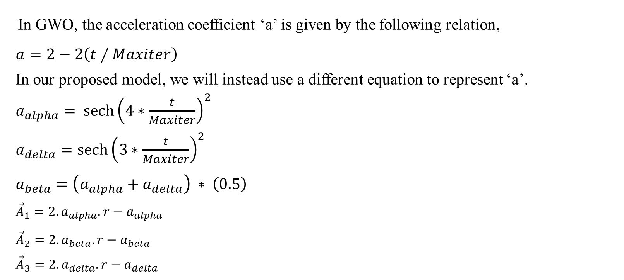
Proposed Methodology (HSLFGWO)
In GWO, the acceleration coefficient ‘a’ is given by the following relation,
$a=2−2\left(t∕Maxiter\right)$
In our proposed model, we will instead use a different equation to represent ‘a’.
$a_{alpha}=$ ${\operatorname{sech}\left(4∗\frac{t}{Maxiter}\right)}^{2}$
$a_{delta}={\operatorname{sech}\left(3∗\frac{t}{Maxiter}\right)}^{2}$
$a_{beta}=\left(a_{alpha}+a_{delta}\right) ∗ \left(0.5\right)$
${\vec{A}}_{1}=2.a_{alpha}.r−a_{alpha}$
${\vec{A}}_{2}=2.a_{beta}.r−a_{beta}$
${\vec{A}}_{3}=2.a_{delta}.r−a_{delta}$

Slide 9
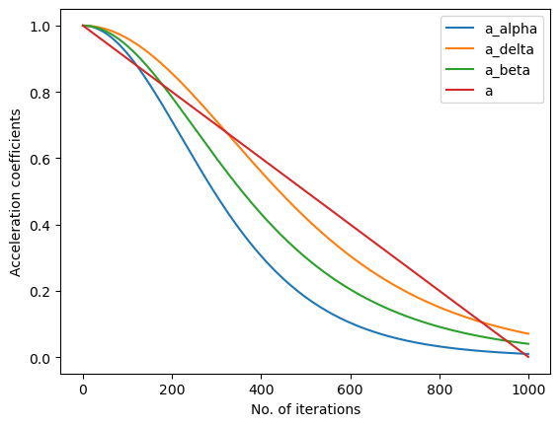
Proposed Methodology (HSLFGWO)
Below picture illustrates the hyperbolic acceleration coefficients in comparison to the linear acceleration coefficient.

Slide 10
Proposed Methodology (HSLFGWO)
The conventional GWO suffers from slow convergence rate and tendency to stuck in local
optima. Therefore, there is a chance of improvement in the search mechanism
of the GWO through different operators.
By integrating levy flights into GWO, the mutated solutions may be able to escape the local optima trap and produce better results.
Following equations are used for the mutation operations,
Xnew = Xbest + N(0,1,dim) ∗ (Xbest − X)
Xnew = Xbest + 0.05 ∗ Levy(ϴ,dim) ∗ (Xbest − X)
N(0, 1, dim) is a function pick dim random numbers from the normal distribution.

Slide 11
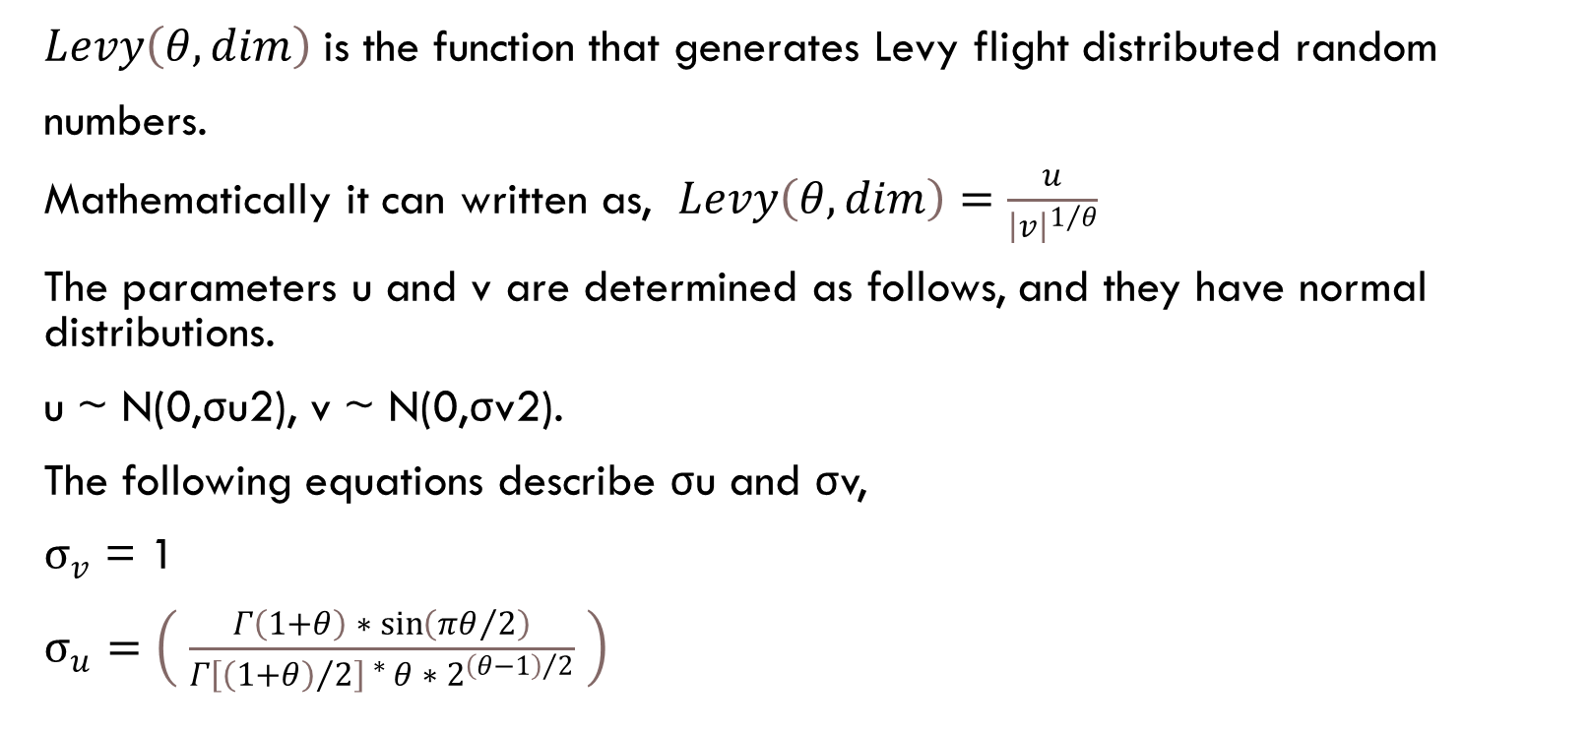
Proposed Methodology (HSLFGWO)
$Levy\left(θ,dim\right)$is the function that generates Levy flight distributed random
numbers.
Mathematically it can written as, $Levy\left(θ,dim\right)=\frac{u}{{\left|v\right|}^{1/θ}}$
The parameters u and v are determined as follows, and they have normal distributions.
u ~ N(0,σu2), v ~ N(0,σv2).
The following equations describe σu and σv,
$σ_{v}$ = 1
$σ_{u}=\left( \frac{Γ\left(1+θ\right) ∗ \sin\left(πθ/2\right)}{Γ{\left[{\left(1+θ\right)}/2\right]}^{ ∗ }θ ∗ 2^{{\left(θ−1\right)}/2}} \right)$

Slide 12
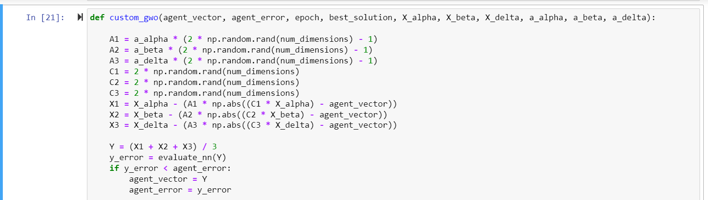
Proposed Methodology (Code Snippet)

Slide 13
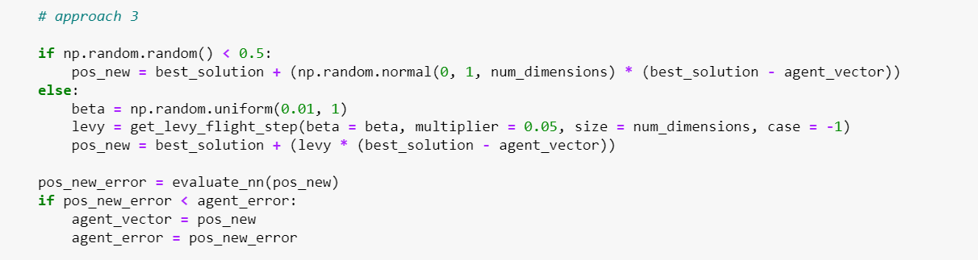
Proposed Methodology (Code Snippet)

Slide 14
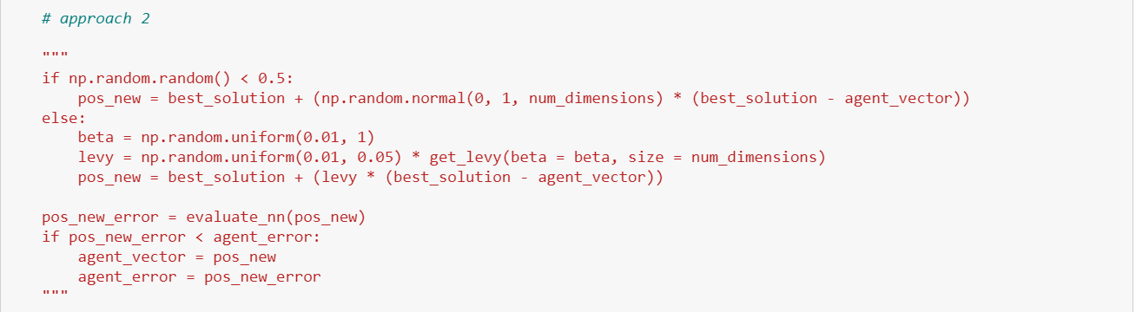
Proposed Methodology (Code Snippet)

Slide 15
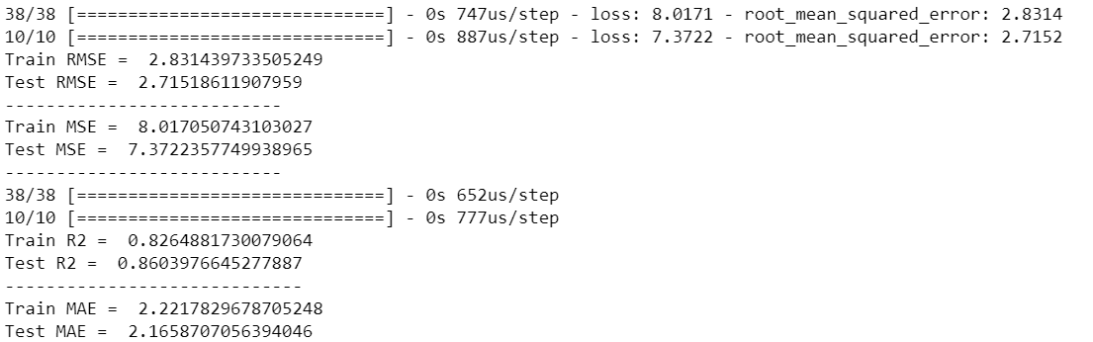
Results
The proposed model was built using the UCI Airfoil dataset with a train-test split of 80:20. Number of solutions used in the population were 20 and the model was trained for 1000 iterations. Below are the results,

Slide 16
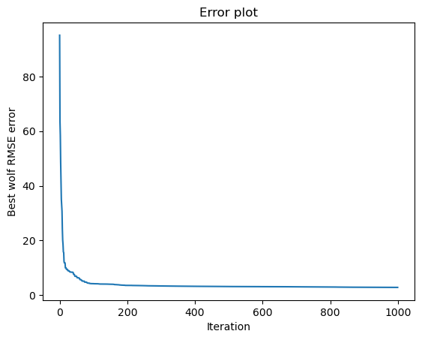
Results

Slide 17
Model | RMSE(Train) | RMSE(Test) | MAE(Train) | MAE(Test) | R2 Score (Train) | R2 Score (Test)
ANN with Ant Lion Optimizer | 8.7 | 8.97 | 6.83 | 6.92 | -0.608 | -0.625
ANN with Satin Bowerbird Optimizer | 6.26 | 6.97 | 4.92 | 5.53 | 0.17 | -0.02
ANN with GWO | 5.25 | 5.53 | 4.22 | 4.28 | 0.42 | 0.32
ANN with Hyperbolic GWO | 4.06 | 4.11 | 3.06 | 3.028 | 0.648 | 0.65
ANN with Adam | 2.64 | 2.73 | 2 | 2.07 | 0.85 | 0.84
Proposed ANN with HSLFGWO | 2.83 | 2.71 | 2.22 | 2.165 | 0.826 | 0.8603

Slide 18
References
https://www.sciencedirect.com/science/article/pii/S0955799723005520 (Base paper)
https://link.springer.com/article/10.1007/s00366-017-0567-1 (Inspiration behind proposed equations)
https://www.sciencedirect.com/science/article/pii/S0957417421017346 (Levy flights reference)
https://www.sciencedirect.com/science/article/pii/S2288430016301142 (Chaotic GWO)

